Slide 1
mochi.
_{a text based game.}

Slide 2
mochi
PROJECT MOCHI
Welcome to
our game.

Slide 3
mochi
INTRODUCTION
Who
We are.

Slide 4
PRODUCER / PROGRAMMER
Baudric Chia
Our Team Leader is the most important role of all. Whipping the project into place is no easy task and Baudric is the best person for it.
LEARN MORE
Introduction
Game Concept
Core Features
Scope
Potential Issues

Slide 5
PHYSICS PROGRAMMER
Wen Jin
Brilliant programmer and great at creating solutions. Wen Jin is set to build the math and physics library.
LEARN MORE
Introduction
Game Concept
Core Features
Scope
Potential Issues

Slide 6
PROGRAMMER / STORYWRITTER
Kenneth Ong
Entrepreneurial activities differ substantially depending on the type of organization
LEARN MORE
Introduction
Game Concept
Core Features
Scope
Potential Issues

Slide 7
LEVEL DESIGNER
Jun Hao
Creating the level design is no simple task, especially for a game like “ Who’s that mochi. “
LEARN MORE
Introduction
Game Concept
Core Features
Scope
Potential Issues

Slide 8
mochi
Game concept
In a nutshell.

Slide 9
GAME CONCEPT SYNOPSIS
“Who’s that mochi” is a game where you experience the life of a mochi as an escapee through a maze puzzle set in an underground dungeon.
Introduction
Game Concept
Core Features
Scope
Potential Issues

Slide 10
Unique
LIFE OF A MOCHI
Unique selling
point.
PROJECT MOCHI
01
Mochi is vulnerable to the elements, making him frail and weak to anyone and anything. Using Mochi-ism as his advantage, he can grow or shrink to escape his enemies.
02
04
06
Introduction
Game Concept
Core Features
Scope
Potential Issues

Slide 11
Unique
TO DO OR NOT TO DO
Unique selling
point.
PROJECT MOCHI
02
Let the player experience how to survive with limited resources and think about ways to solve each level.
04
06
Introduction
Game Concept
Core Features
Scope
Potential Issues
Notes:
To change the image behind the Mock up.
Select the layer - > Right Click -> Send to Back -> Delete the image -> Drag & Drop your Own Picture -> Send to Back (again)

Slide 12
PROJECT MOCHI
mochi
INTRODUCTION
Team
Logo.
04
06
Introduction
Game Concept
Core Features
Scope
Potential Issues

Slide 13
PROJECT MOCHI
mochi
INTRODUCTION
Game
Logo.
06
WHO’S THAT MOCHI?
Introduction
Game Concept
Core Features
Scope
Potential Issues

Slide 14
MOCHI.
PROJECT MOCHI
Mood board
Introduction
Game Concept
Core Features
Scope
Potential Issues

Slide 15
MOCHI.
PROJECT MOCHI
Mood board
Introduction
Game Concept
Core Features
Scope
Potential Issues

Slide 16
INSPIRATION AROUND THE WORLD
Concept
visuals
Concept
visuals
Enter the Gungeon ( Dungeon Reference )
Introduction
Game Concept
Core Features
Scope
Potential Issues

Slide 17
INSPIRATION AROUND THE WORLD
Concept
visuals
Concept
visuals
Dwarf Fortress ( Game visual reference)
Introduction
Game Concept
Core Features
Scope
Potential Issues

Slide 18
INSPIRATION AROUND THE WORLD
Concept
visuals
Concept
visuals
Invisible inc ( Puzzle Reference )
Introduction
Game Concept
Core Features
Scope
Potential Issues

Slide 19
INSPIRATION AROUND THE WORLD
Concept
visuals
Concept
visuals
Sproggiwoods ( Gameplay Reference )
Introduction
Game Concept
Core Features
Scope
Potential Issues

Slide 20
mochi
Core features
Of mochi.

Slide 21
CORE FEATURES 01
Experience
Experience the Mochi way of life.
Introduction
Game Concept
Core Features
Scope
Potential Issues

Slide 22
CORE FEATURES 02
Puzzles
Mind boggling puzzle
Introduction
Game Concept
Core Features
Scope
Potential Issues

Slide 23
CORE FEATURES 03
Combat
Fighting enemies
Introduction
Game Concept
Core Features
Scope
Potential Issues

Slide 24
PLAYER CHARACTER
You play as
Bean Lychee
Introduction
Game Concept
Core Features
Scope
Potential Issues
Notes:
To change the image behind the Mock up.
Select the layer - > Right Click -> Send to Back -> Delete the image -> Drag & Drop your Own Picture -> Send to Back (again)

Slide 25
PLAYER CHARACTER
You play as
Bean Lychee
Introduction
Game Concept
Core Features
Scope
Potential Issues
Notes:
To change the image behind the Mock up.
Select the layer - > Right Click -> Send to Back -> Delete the image -> Drag & Drop your Own Picture -> Send to Back (again)

Slide 26
MECHANICS
PROJECT MOCHI
PRIMARY MECHANICS
UNIQUE SELLING POINT
Size dependent exit doors
Mochi Struggles with:
Movement [ -hp ]
Self Defense requires parts of himself
Environment Traps
Mochi have powers.
Introduction
Game Concept
Core Features
Scope
Potential Issues

Slide 27
mochi
Scope &
Project Timeline.

Slide 28
MAIN FEATURES #1
Special Abilities
Mochi have powers such as
The whip
Sticky Traps
Introduction
Game Concept
Core Features
Scope
Potential Issues

Slide 29
MAIN FEATURES #2
Interaction with
environment
Mochi is able to grow and shrink to bypass doorways and exits.
Introduction
Game Concept
Core Features
Scope
Potential Issues

Slide 30
MAIN FEATURES #3
Animated Cutscene
Pixel animated cutscene using printf()s to make the story more interactive.
Introduction
Game Concept
Core Features
Scope
Potential Issues

Slide 31
mochi
Project
Timeline

Slide 32
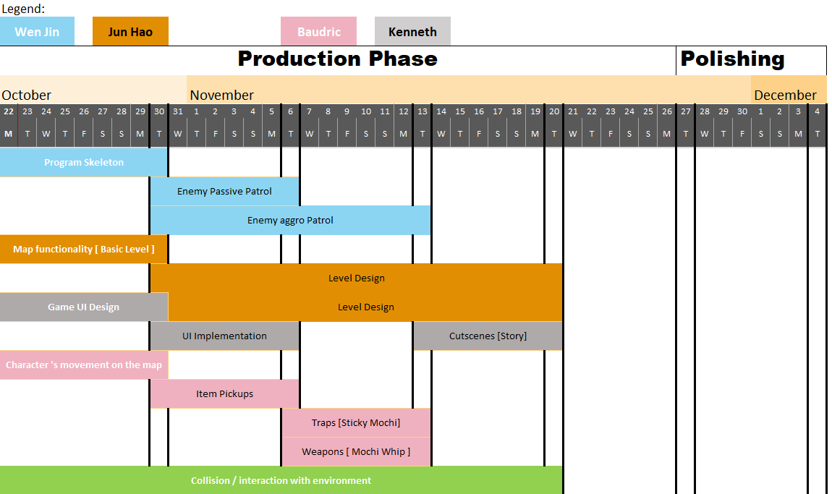
YOU CAN WRITE HERE
PROJECT MOCHI
Project Timeline
Introduction
Game Concept
Core Features
Scope
Potential Issues

Slide 33
mochi
Risk and
Potential issues.

Slide 34
PROJECTED RISKS
Scaling and shrinking of Mochi
Converting Viewpoint of game from top down to a sort of side aerial view [bomber-man style]
Will be doing everything on a top-down basis first, aesthetics later
MITIGATION
Introduction
Game Concept
Core Features
Scope
Potential Issues

Slide 35
PROJECTED RISKS
Level
Design
Very difficult to come up with a complex level design as well as balance the puzzle.
1 Tutorial map, 4 more progressive learning maps W new elements introduced slowly, last 3 maps difficult to clear with all elements included
MITIGATION
Introduction
Game Concept
Core Features
Scope
Potential Issues

Slide 36
PROJECTED RISKS
Enemy
Pathing
No idea how to create a pathing algorithm to "hunt" for Mochi if he is found
Design a fixed enemy patrol route system first
MITIGATION
Introduction
Game Concept
Core Features
Scope
Potential Issues

Slide 37
Thank you
_{mochi.}

